Slide 1
Trees and its types

Slide 2
Agenda
Trees
Structure of Trees
Types of Trees
Applications of Trees

Slide 3
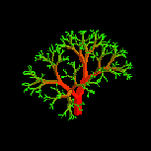


Trees
Trees that nature lovers see:
Notes:
Trees are a very useful data structure. Many different kinds of trees are used in Computer Science. We shall study just a few of these.

Slide 4
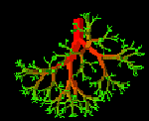
Trees that computer scientists see:
root
leaves
nodes
Notes:
Branches meet at nodes.

Slide 5
Trees
Definition: A tree is a finite set of two or more nodes and branches such that, there is a root node which starts the tree, the remaining nodes are divided into n ≥ 0 disjoint sets T1, T2, …. Tn, where each of these sets is a subtree of the complete tree.
We also call T1, T2, ..., Tn are the subtrees of the root.

Slide 6
Structure of Trees
T1
T2
T3

Slide 7
Types of Trees
Trees
General Trees
Binary Search Trees
Red Black Trees
Splat Trees
Binary Trees
AVL Trees
Treap
B-Tree

Slide 8
Application of Trees
Indexing in database
In Compilers
Back functionality in Browser
To store possible moves in a Chess Game
and many more...

Slide 9
Summary
Understood trees and its types in Computer Science.
Seen Applications of trees.

Slide 10
Thank You
Proprietary content. ©Great Learning. All Rights Reserved. Unauthorized use or distribution prohibited

